Slide 1



Data Drift in a Seq2Seq Model
for Trajectory Prediction in RoboCup SSL
Ivan G. Yamasaki · Advisors: Prof. Dr. Marcos R. O. A. Máximo / Prof. Dr. Paulo M. Tasinaffo
Instituto Tecnológico de Aeronáutica · July 2026

Slide 2
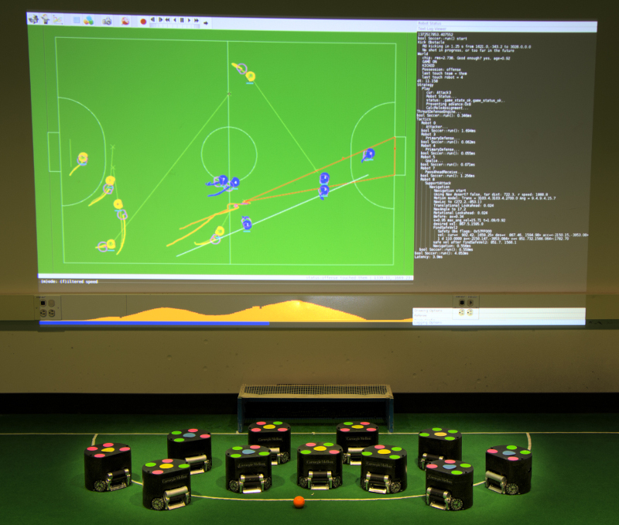
Introduction and motivation
More accurate prediction today; better league strategies tomorrow
CONTEXT
Trajectory prediction supports real-time decisions in the Small Size League.
GAP
A model trained in one season can silently degrade in future league seasons.
OBJECTIVE
Measure the drift, explain its origin, and define how to adapt and when to retrain.
02

Slide 3
Research questions
A temporal evaluation of the seq2seq predictor
How much?
Why?
What to do?
How does ADE change between 2019 and 2025?
What share comes from covariate shift, and which variables explain it?
How to adapt without forgetting, and how to signal when to retrain?
03

Slide 4
Data and protocol
Official logs from the RoboCup SSL world championships
1 · Dataset
2 · Stream
3 · Evaluation
Official logs 2019–2025
6 Division A games per
tournament · 36 in total
no competition in 2020
8k windows/game
288k trajectories
temporal order preserved
ADE in millimeters
horizons 30→15 and 60→30
2019 = reference
The baseline uses the six 2019 games: with a single game, ADE ranges from 4.53 to 6.20 mm.
04

Slide 5
Model and baseline
A clean comparison between a learned model and a fixed kinematic comparator
Input
Seq2Seq
Output
[x, y, vx, vy, sin ψ, cos ψ]
ψ = robot orientation
30 / 60 observed steps
→
LSTM encoder (128)
additive attention (Bahdanau et al.)
autoregressive decoder
→
15 / 30 future positions
ADE as the metric
baseline: constant-velocity
Kalman filter
The model predicts incremental velocities, so it is directly sensitive to kinematic changes.
05

Slide 6
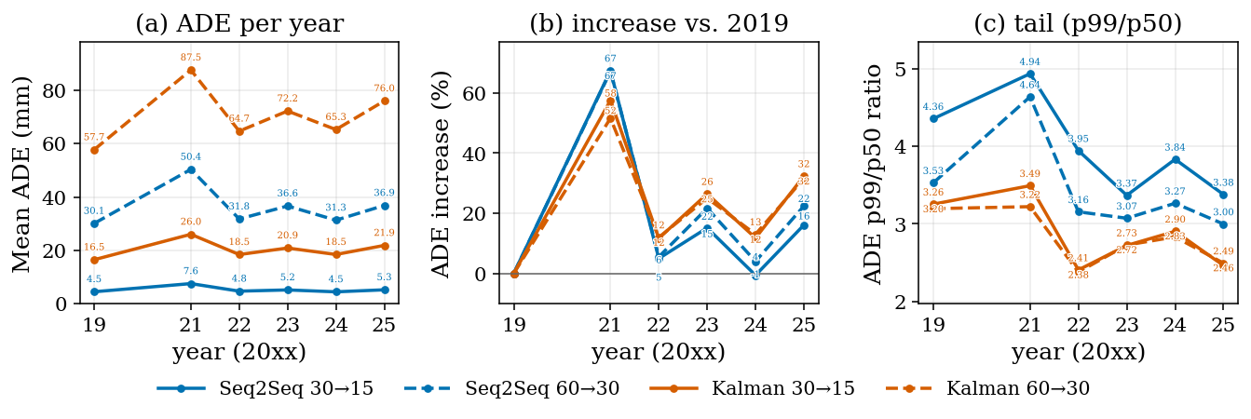
Result 1 — the drift is real
Accuracy loss grows as we move away from the training season
These are two separate effects: the 2021 jump (simulated tournament) and the gradual trend from 2022 to 2025, both measured against 2019.
06

Slide 7
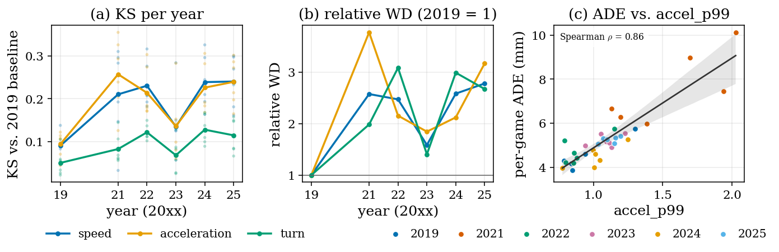
Result 2 — acceleration leads the change
The kinematic tail explains where the new regime comes in
KS and Wasserstein drift away from the 2019 baseline; accel_p99 is associated with the per-game ADE increase.
07

Slide 8
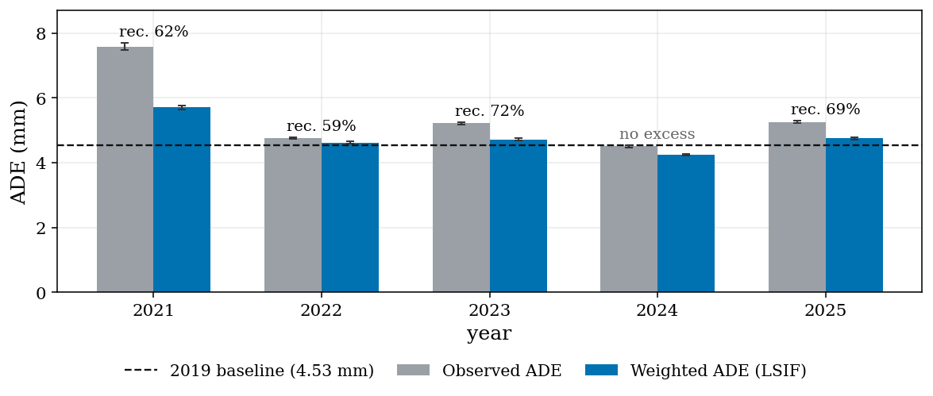
Result 3 — covariate shift predominates
Reweighting 2019 examples with LSIF recovers most of the excess error
LSIF attributes 59–72% of the excess to covariate shift; an independent classifier confirms change in every season.
08

Slide 9
Adapting to drift
The goal is to capture the new regime without losing performance on the old one
COMMON PROTOCOL
LIGHT UPDATE
CRITERION
Old regime: 2019
New data: 2022–2025
500 trajectories per game
2021 excluded (simulated tournament)
Frozen encoder
2 trainable decoder layers
lr 10⁻⁵ · 5 epochs
cat_ratio = fraction of old trajectories that get worse
Lower is better: it measures catastrophic forgetting
09

Slide 10
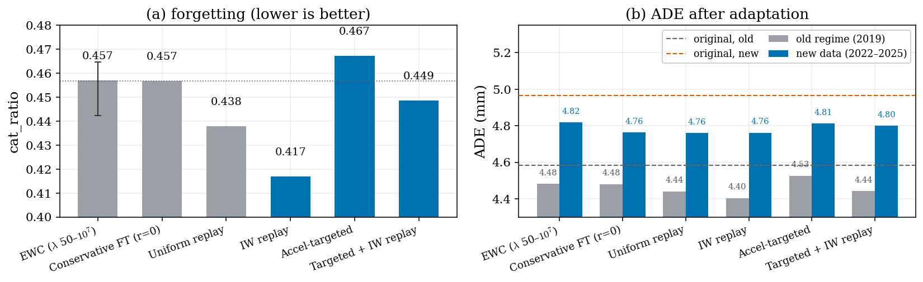
Result 4 — weighted replay is the best answer
Restricting adaptation to the most extreme acceleration slice worsens forgetting
Light fine-tuning reduces cat_ratio from 0.82 to ~0.46. Importance-weighted replay reaches the lowest value (0.417); EWC is inert.
10

Slide 11
Online detection
From the statistical diagnosis of ADWIN / KSWIN to the operational decision to retrain
01 Signal
02 Calibration
03 Action
Per-trajectory ADE
locally normalized
median + MAD (w=200)
→
ADWIN on a 96-config grid
2-fold by games
separate selection and test
→
primary alarm
→ retrain
auxiliary layers
→ monitor and confirm
Operational question: is the signal reliable enough to trigger retraining?
11

Slide 12
Layered detection architecture
Based exclusively on the paper's protocol and results
Layer
Signal
FAR / 1k
(A / B)
Coverage
(A / B)
Action
Primary
Seq2seq ADE
0.042 / 0.125
5/5 · 4/5
retrain
Surveillance
accel_p95
0.292 / 0.250
5/5 · 5/5
monitor
Confirmation
AND(ADE, accel)
0.000 / 0.000
3/5 · 2/5
confirm
Corroboration
Kalman filter ADE
0.167 / 0.083
5/5 · 5/5
redundancy
Out-of-sample results. The acceleration layer anticipates the error layer in 8 of 10 yearly folds.
12

Slide 13
Result 5 — a reliable primary detector
ADWIN on the normalized error achieves a low out-of-sample alarm rate
0.042 – 0.125
9 / 10
0.2 – 1.5
PER THOUSAND TRAJECTORIES
COVERAGE
GAMES OF LATENCY
false alarms in 2019, in folds A and B
(admissibility ceiling: 0.20)
year-folds with at least one alarm
in the season where drift occurred
until the first alarm after each
season changeover
WITHOUT NORMALIZATION THERE IS NO DETECTOR
WITHOUT A HOLDOUT, A DIFFERENT CHOICE
None of the 96 configurations is admissible on the raw signal, and the 21 smoothers tested worsen the FAR.
The in-sample winning configuration keeps FAR ≈ 0 but covers only 2–3 of 5 seasons out of sample.
All numbers are out-of-sample: calibration uses half of each year's games and the other half is evaluated exactly once.
13

Slide 14
Conclusions
What the study delivers
MEASURE
EXPLAIN
ACT
Persistent drift after training. The Kalman filter baseline degrades even more, because the robots move away from the constant-velocity model.
59–72% of the excess is covariate shift, with tail acceleration as the dominant driver.
Weighted replay reduces forgetting; normalized ADWIN provides a measurable trigger for retraining.
14

Slide 15
Limitations and next steps
Where the conclusions should be interpreted with care
LIMITATIONS
OPERATIONAL CAUTION
NEXT STEPS
2021 mixes the sim-to-real gap with seasonal drift.
Only Division A and six games per season.
ADE is a single-mode metric.
Robust normalization assumes gradual drift.
There is autocorrelation between trajectories.
The residual concept-drift fraction was not isolated per variable.
Retrain the encoder.
Scale up weighted replay.
Evaluate multimodal predictors and more seasons.
15

Slide 16
Essential references
Works that structure the model, the diagnosis, and the detection
Steuernagel, L.; Máximo, M. R. O. A. Trajectory prediction for SSL robots using seq2seq neural networks. RoboCup 2022, LNCS 13561, Springer, 2023.
Gama, J. et al. A survey on concept drift adaptation. ACM Computing Surveys, 2014.
Bifet, A.; Gavaldà, R. Learning from time-changing data with adaptive windowing (ADWIN). SDM, 2007.
Kanamori, T.; Hido, S.; Sugiyama, M. A least-squares approach to direct importance estimation (LSIF). JMLR, 2009.
16

Slide 17
Thank you!
Questions and discussion
github.com/IvanYamasaki/trajectory-prediction

